Slide 1
Networking
White board

Slide 2
PROBLEM STATEMENT
There should be a single presenter writing on the whiteboard.
Any number of clients can connect as listeners at any time.
The listeners joining the presentation after it has started should get the previous data written on the whiteboard instantly.
The listeners should receive what is being written on the whiteboard simultaneously as it is being written.
The presentation should terminate when the presenter leaves.

Slide 3
ASSUMPTIONS
There is one presenter and only he can write to the white board.
Only alphanumeric characters, space and newline character can be used while writing on the white board.
Characters once written cannot be removed using backspace.
The presentation will end normally only when presenter will press Ctrl + C.

Slide 4
FILES USED
file.txt - stores the data entered by the presenter to keep the record for upcoming clients.
Presenter_Password.txt - stores the username and password of the presenter
Listener_Password.txt - stores the username and password of the listeners

Slide 5
NORMAL SCENARIO AT SERVER SIDE
Socket ( )
Store Information
bind ( )
listen ( )

Slide 6
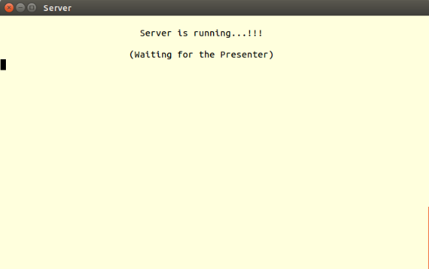
ON RUNNING SERVER

Slide 7
NORMAL SCENARIO AT CLIENT
SIDE
Socket ( )
bzero ( )
Store Information
connect()

Slide 8
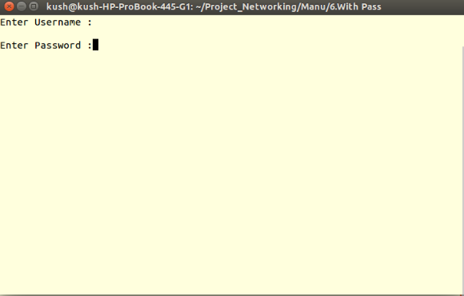
ON RUNNING CLIENT

Slide 9
Authentication of Clients
Presenter
U-name & Pass
Correct
If
Present = 0
Welcome
Presenter
Correct
For
Presenter
Invalid
Incorrect
Already
Present
Incorrect
Server
For
Listener
Listener
U-name & Pass
If
Present = 0
Welcome
Listener
Correct
Correct
Invalid
No Presentation
Incorrect
Incorrect

Slide 10
HOW CONNECTION IS MADE ?
Client 1
Server
connfd
Authenticated
Child Server 1
connfd

Slide 11
Lets see the code !!!

Slide 12
Thank You !!!
Made by:
Kushagra Gupta (1211)
Manpreet Kaur (1217)

